Slide 1

Blockchain and Its Applications CertChain
Minmei Wang
Computer Science and Engineering

Slide 2
Outline
Background
Blockchain (bitcoin)
CertChain

Slide 3



Background
Centralized trading system
A trusted third party

Slide 4
Background
Centralized DNS
A trusted third party

Slide 5
Background
Centralized PKI
A trusted third party

Slide 6
Background
Problem
  Single point of failure
  What if the system is decentralized and there is no trusted third party?
  We need a distributed ledger
  (blockchain)

Slide 7
Outline
Background
Blockchain (bitcoin)
CertChain

Slide 8
Blockchain
Blockchain
It looks like a file
Append-only global log
Every node on the network has a consistent copy
Bitcoin is the most secure blockchain.

Slide 9

Bitcoin
Bitcoin: A Peer-to-Peer Electronic Cash System
Satoshi Nakamoto
[1] Nakamoto, Satoshi. "Bitcoin: A peer-to-peer electronic cash system." (2008): 28.

Slide 10
Motivation
Design a decentralized system to conduct direct transaction between any two parties
Solve the double-spending problem
Rely on proof instead of trust
  Everyone can’t be trusted in the network

Slide 11




Motivation
Double-spending problem
  digital money can be spent twice
spent
spent twice
Data tampering

Slide 12

Bitcoin components
A list of transactions
Miners that mine the block in the network
Blockchain that records the valid transactions

Slide 13
Transactions
A transfers coins to B
B transfers coins to C
Transaction:
Transaction:
Shows the receiver
Owner B’s public key
Owner C’s public key
Hash
Hash
The address is the owner’s public key
Owner A’s Signature
Owner B’s Signature
Owner B’s Private Key
Shows the sender

Slide 14
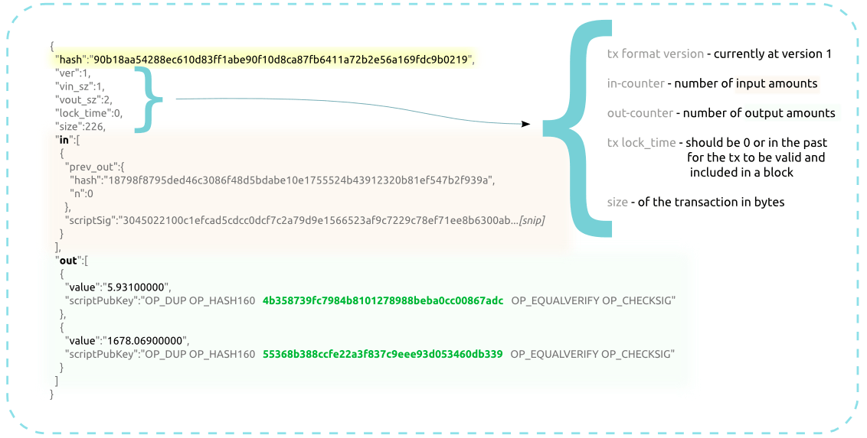
Transactions
address
Notes:
Let’s look at a real transaction in the bitcoin. The in indicates the input, which is a hash pointer. The out contains the address of the person will be sent and the amount of coin.

Slide 15
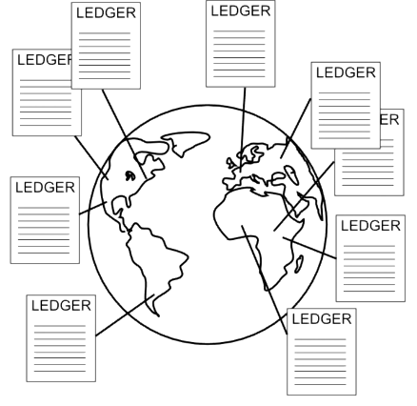

Blockchain
A group of nodes
Blockchain
Record transactions in the network
miner
Notes:
Every node in the bitcoin network should store the blockchain or ledger. So there is a problem, who should create and maintain the blockchain? In the bitcoin system, there are a group of nodes to do this, which called miners. I will interpret why this group of nodes are called miners later.

Slide 16

Threat model
A list of transactions
Tr
Tr
Tr
Tr
Tr
Tr
Tr
Tr
Tr
Tr
Tr
tamper his past transactions
double-spending
invalid input
output > input
ATTACKER
Notes:
We already know that blockchain can guarantee the correctness of the whole system. So next problem is how to design a blockchain, what’s the structure of the blockchain. Before this, we first consider the threat model in this system. There are a list of transactions in the bitcoin network. There exists an attacker node, he can do some things to damage the system. first, he can tamper his past transactions, because he has the private key. And if there is a double—spending problem, which means two transactions have the same input, or the input of the transaction is nonexistent. how to solve these threat by blockchain?

Slide 17
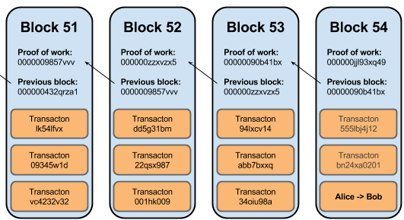
Blockchain
Transactions are organized as blocks
Blocks are linked
Notes:
Bitcoin solves these problems by the design of blockchain. In the bitcoin, blocks are linked and it uses proof-of-work. Blocks are linked, which means the next block has a hash pointer to the last block. We will interpret it one by one. And this can also show how the blockchain is generated.

Slide 18
Blockchain
Transactions are organized as blocks
Blocks are linked
Verify every transaction when adding a transaction into a block.
Notes:
Bitcoin solves these problems by the design of blockchain. In the bitcoin, blocks are linked and it uses proof-of-work. Blocks are linked, which means the next block has a hash pointer to the last block. We will interpret it one by one. And this can also show how the blockchain is generated.

Slide 19
Verification
Double-spending problem
  Verify every transaction in the block
  The input is authorized and has not been spent
A transfers coins to B
B transfers coins to C
Transaction:
Transaction:
Shows the
receiver
Owner B’s public key
Owner C’s public key
Hash
Hash
Owner A’s Signature
Owner B’s Signature
Owner B’s Private Key
Shows the sender
Notes:
First, it must verify the input is authorized. The public key is contained in the transaction, you can compare with each other to make sure the input is authorized.

Slide 20
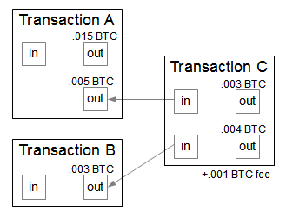
Verification
  Verify every transaction in the block
  The output can’t exceed the input
    Compare the input coin and output coin
source: http://static.righto.com/images/bitcoin/transaction_diagram.png
Notes:
And then verify the input has not been spent. Because the miner has all the past transactions, it can see whether the input has been spent or not. This can solve a part of double-spending problem. We will talk another case of double-spending problem later.
The last one is to verify the output can’t exceed the input. After the three processes, this transaction can be seen as valid. After the verification, we can solve the double-spending problem and invalid input problem.

Slide 21
Blockchain
Transactions are organized as blocks
Blocks are linked
Verify every transaction when adding a transaction into a block.
Use proof-of-work to manage the blocks
Notes:
Bitcoin solves these problems by the design of blockchain. In the bitcoin, blocks are linked and it uses proof-of-work. Blocks are linked, which means the next block has a hash pointer to the last block. We will interpret it one by one. And this can also show how the blockchain is generated.

Slide 22
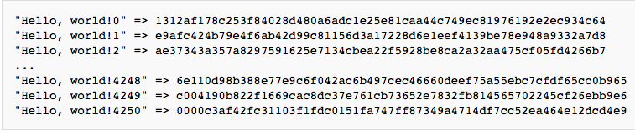
Proof-of-Work
Proof-of-work is a piece of data which is difficult to produce but easy for others to verify and satisfies certain requirements
Block:
Block:
Prev Hash
Nonce
Prev Hash
Nonce
Tx1
Tx2
Txn
Tx1
Tx2
Txn
Increment nonce until finding a nonce to make the hash begin with the required zero bits.
Notes:
Next we will talk about the proof-of-work, why we need proof-of-work here? Proof-of-work here is by incrementing a nonce in the block until a value is found that gives the block’s hash the required zero bits. After 4250 try in the figure, this block completes the process of proof-of-work.

Slide 23
Proof-of-Work
Functions
  Manage order of transactions in the block
  Decide the miner of the block
    When a miner generates a block, the miner will broadcast the block to the network.
    The nodes in the network accept the first block it receives.
    If there are two blockchains, the nodes choose the longest chain.
  Decrease the probability that attacker tampers the transaction in the blockchain

Slide 24
Proof-of-Work
Block100:
Block101:
Block102:
Nonce
Prev Hash
Nonce
Prev Hash
Nonce
Prev Hash
Nonce
Prev Hash
Nonce
Prev Hash
Nonce
Tx1
Tx2
Txn
Tx1
Tx2
Txn
Tx1
Tx1
Tx2
Txn
Notes:
If the attacker tampers the data in block100, he needs to redo the proof-of-work until finding a nonce to make the hash of the block begin with the required zero bits. This will result in the changing of the final hash of this block. All the following block101,102 and other will encounter the same problem, so it needs to compute much time. In the bitcoin, …
So in this situation, the attacker will spend more time to generate the block, so it’s probably the block will not be received by the system, which guarantee the security of the whole system

Slide 25
Proof-of-Work
Two incentive mechanisms
Block:
Prev Hash
Nonce
block reward
transaction fees
Tx1
Tx2
Txn
A
If the total output is less than total input, the difference is obtained by A.
create reward coins to A
Notes:
There is a problem, how to make nodes in the network be willing to be this generator? There are two kinds of incentives. The first one is reward transaction.

Slide 26
Blockchain – consistency
Alice’s Block Chain
Bob’s Block Chain
Miya’s Block Chain
The nodes choose the longest chain.
network latency
Notes:
Last, let’s talk about another potential double-spending problem. Suppose Alice, Bob and Miya are the nodes in the bitcoin network. Now they all have the same blockchain. In the next stage, there are three block in the network that each contains a same input but transfers to different address. So the blockchain is different from each other, so how to solve this problem. This problem will be solved when someone solve the next block. The general rule is that you always switch immediately to the longest branch available.

Slide 27
Overview of the Bitcoin network
New transactions are broadcast to all nodes
Each node collects new transactions into a block.
Each node works on finding a difficulty proof-of-work for its block.
When a node finds a proof-of-work, it broadcasts the block to all nodes.
Nodes accept the block only if all transactions in it are valid and not already spent.
Nodes express their acceptance of the block by working on creating the next block in thin, using the hash of the accepted block as the previous hash.
Notes:
Let’s give a brief summary about how does bitcoin work.

Slide 28
Conclusions of Blockchain
Blockchain can use proof-of-work to record a public history of transactions to guarantee the security of the whole network.
Blockchain can deal with the double-spending problem.
Blockchain can be used in many applications for security.

Slide 29
Outline
Background
Blockchain (bitcoin)
CertChain

Slide 30
CertChain: Public and Efficient Certificate Audit Based on Blockchain for TLS connections
Jing Chen, Shixiong Yao, Quan Yuan, Kun He, Shouling Ji, Ruiying Du

Slide 31
Outline
Motivation
CertChain design
Security analysis & experiments
Conclusions

Slide 32
Motivation
In TLS, authentication and secure connection establishment are built based on Public Key Infrastructure (PKI)
Certificate authorities (CAs) are core components of PKI
CAs may be compromised due to their vulnerabilities

Slide 33
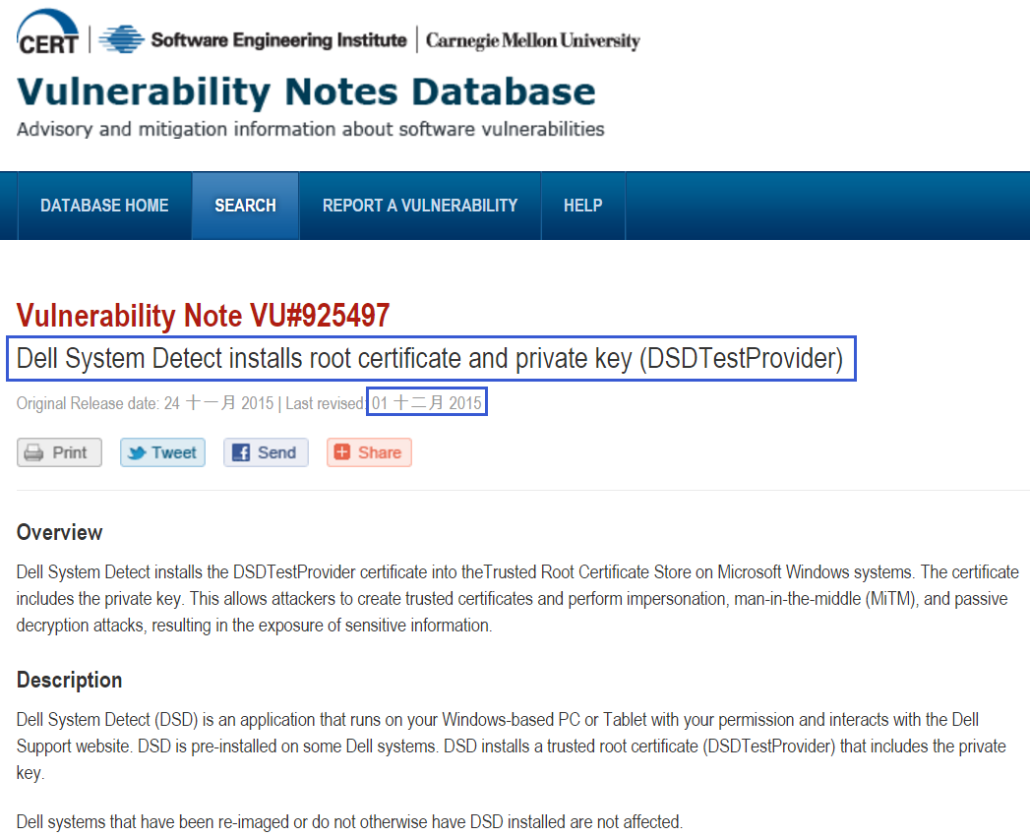
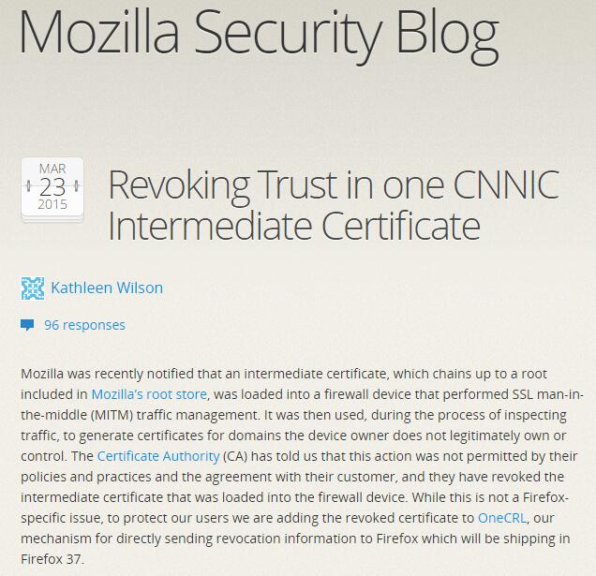
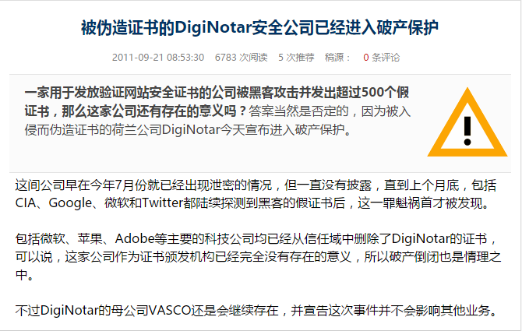
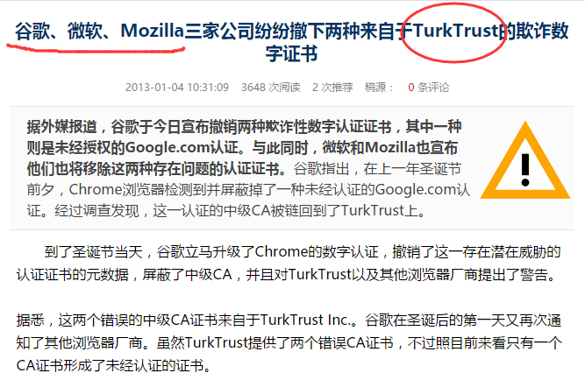
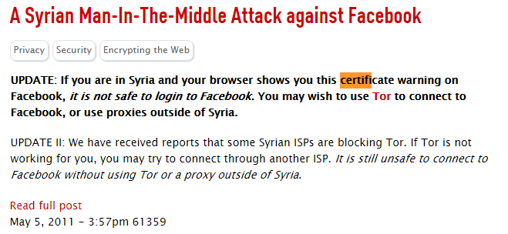
I. Introduction
Motivation

Slide 34
Drawbacks of existing work
CA-based trust disperse
  Have to verify the identity of the witness and its public key
  Bring in the problem of sustainable service
  Too expensive to implement
Log-based misbehavior monitor
  Expand the attack surface of the whole system.
  Do not provide a secure certificates synchronization protocol.
  Do not provide sufficiently incentive to monitor entities’ behavior.

Slide 35
Drawbacks of existing work
Enhancing certificate revocation service
  have significant difficulty in scaling to handle millions of certificates
  pack vast revocation information in tiny space
  aggregate and store revocation information in a space-efficient filter cascade data structure.

Slide 36
CertChain: A comprehensive certificate management system based on blockchain

Slide 37
I. Introduction
Challenges
Centralization in practice
Mandatory traversal
POW/POS/DPOS have privileged nodes
Unrelated certificates
Block size limitation
The size of CRL may exceeds the capacity of one block
Number of revoked certificates keeps increasing
These nodes generate most of the blocks
Control the blockchain to some extent
Traverse the whole blockchain is tedious and time-consuming
05
Notes:
which possess the stronger computing ability or more stake in the system
2. if we need to learn a domain’s history certificate operations in blockchain
3. more blocks are generated in order to store this revocation information.

Slide 38
Threat model
Communications in networks are untrusted
An active adversary can
  Manipulate a victim’s web traffic
  Compromise any entity
  Eavesdrop, tamper, and forge messages of communications
An active adversary cannot
  Forge signatures without getting the private key
  Control more than 51% nodes in blockchain

Slide 39
Threat model
Goals for adversaries
  Issue a certificate for a malicious domain without being detected
  Insert, delete, or tamper the certificate operations for making clients’ certificates validation failure
  Control the blockchain

Slide 40
System Model

Slide 41
CertChain Design

Slide 42
III. CertChain Design
Overview of CertChain
CertChain
Application layer
Certificate Operation
Certificate validation
Extension layer
Consensus protocol
Incentive
mechanism
Network layer
P2P
Flooding
Data layer
CertOper
MHT
DCBF

Slide 43
III. CertChain Design
Overview of CertChain
CertChain
Application layer
Certificate Operation
Certificate validation
Extension layer
Consensus protocol
Incentive
mechanism
Network layer
P2P
Flooding
Data layer
Define the structure of the data and design for certificates revocation checking

Slide 44
III. CertChain Design
Data layer
1. CertOper definition:
Subject name
the name of a domain
Operator name
the name of a CA
Operation type
the type of certificate operation
Timestamp & NotAfter
the generation time of an operation, and the expiration time Current
Certificate Hash
the hash of the subject domain’s certificate
Last Operation Height
Filled in the block height of the subject’s last certificate operation
Version Number, Signature Algorithm ID, Signature Value, Extension Field
Notes:
1 who requests a certificate operation
2 who signs a certificate and generates this data structure
4 used by bookkeepers to clear the expired revocation information
5. which is used for the process of certificate validation.

Slide 45
III. CertChain Design
Data layer
1. CertOper definition
Notes:
1 who requests a certificate operation
2 who signs a certificate and generates this data structure
4 used by bookkeepers to clear the expired revocation information
5. which is used for the process of certificate validation.

Slide 46




III. CertChain Design
Data layer
2. An efficient revocation checking method--DCBF-Dual Counting Bloom Filter
$CBF_{1}$: valid certificates
0
0
1
2
$$Cer{tOper}_{A}$$
A
0
0
A
0
0
0
1
1
0
1
0
1
…
0
0
1
0
0
1
1
0
0
B
B
0
0
$CBF_{2}$: revoked certificates
0
0
1
2
$$Cer{tOper}_{B}$$
0
0
BF
CBF
1
1
0
0
…
1
1
0
Notes:
Drawback: Not a complete revoked certificates

Slide 47
III. CertChain Design
Overview of CertChain
CertChain
Application layer
Certificate Operation
Certificate validation
Extension layer
Describe consensus protocol and incentive mechanism
Network layer
P2P
Flooding
Data layer
CertOper
MHT
DCBF

Slide 48
III. CertChain Design
Extension layer
Block and blockchain
Genesis block (B₀)
$$B_{0}=\{\left(vk_{1}, d_{1}\right), …,(vk_{n}, d_{n})\}$$
𝐵_0={(𝑣𝑘_1, 𝑑_1 ), …,(𝑣𝑘_𝑛, 𝑑_𝑛)}
Block
$$B_{i}=(st_{i−1},op,sl_{k},σ)$$
𝐵_𝑖=(𝑠𝑡_(𝑖−1),𝑜𝑝,𝑠𝑙_𝑘,𝜎)
Blockchain
$B_{0}, B_{1} ,…, B_{n}$, $st_{i}=H\left(B_{i−1}\right)$, $len\left(𝒞\right), head(𝒞)$
𝐵_0, 𝐵_1 ,…, 𝐵_𝑛, 𝑠𝑡_𝑖=𝐻(𝐵_(𝑖−1) ), 𝑙𝑒𝑛(𝒞), ℎ𝑒𝑎𝑑(𝒞)
Dependability-rank
$d_{i}$ is used to express the dependability degree of a bookkeeper or a CA
𝑑_𝑖 is used to express the dependability degree of a bookkeeper or a CA
Notes:
Blockchain is maintained by bookeepers

Slide 49
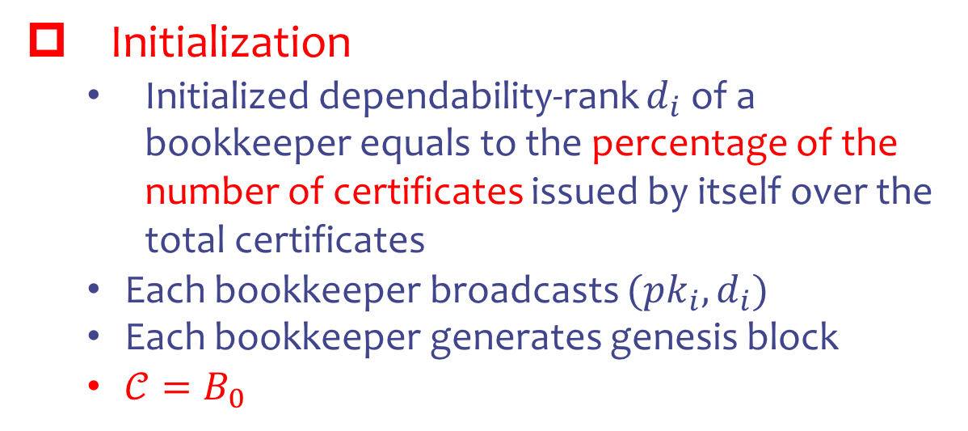
III. CertChain Design
Extension layer
2. The dependability-rank based consensus protocol
Initialization
  Initialized dependability-rank $d_{i}$ of a bookkeeper equals to the percentage of the number of certificates issued by itself over the total certificates
  Each bookkeeper broadcasts $({pk}_{i},d_{i})$
  Each bookkeeper generates genesis block
  $𝒞=B_{0}$

Slide 50
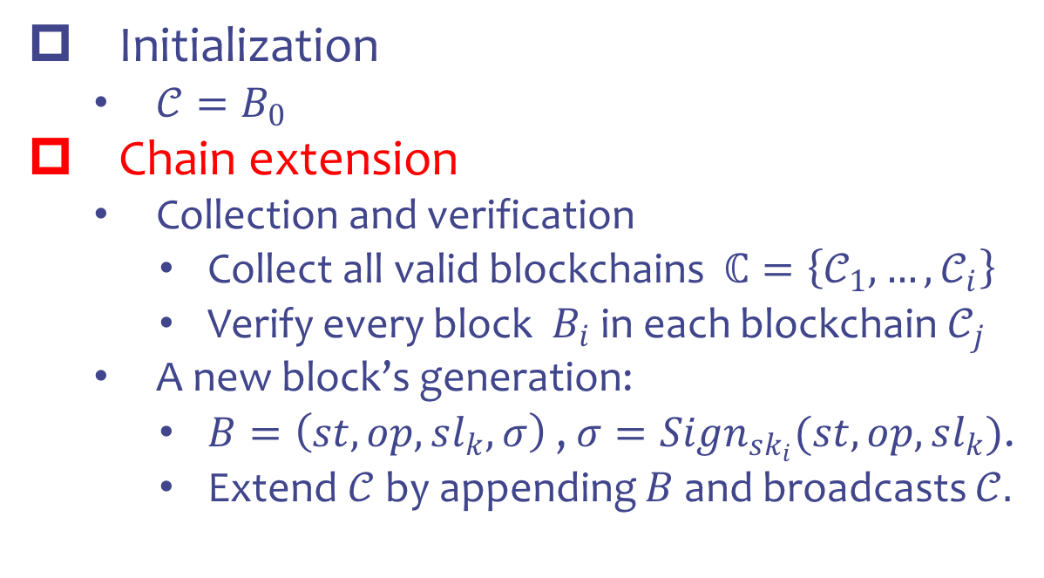
III. CertChain Design
Extension layer
2. The dependability-rank based consensus protocol
Initialization
  $𝒞=B_{0}$
Chain extension
  Collection and verification
    Collect all valid blockchains $ℂ=\left\{𝒞_{1}, …, 𝒞_{i}\right\}$
    Verify every block $B_{i}$ in each blockchain $𝒞_{j}$
  A new block’s generation:
    $B=\left(st, op, sl_{k}, σ\right)$ , $σ=Sign_{sk_{i}}(st, op, sl_{k})$.
    Extend $𝒞$ by appending $B$ and broadcasts $𝒞.$

Slide 51
III. CertChain Design
Extension layer
Issue a valid certificate
Generate related operation
Report misbehavior
3. Incentive mechanism
CA
Economic benefit
misbehavior
Bookkeeper
$D=\{d_{1}, d_{2},…,d_{n}\}$ is initialized by CA’s certificates operation
𝐷={𝑑_1, 𝑑_2,…,𝑑_𝑛} is initialized by CA’s certificates operation
The leader election
Sign illegal certificate
Issue forge revocation
Leader election
Omitting certificate operations
Leader: The bookkeeper related to a CA that has the maximum dependability-rank
Notes:
CA shares the dependability-rank with the corresponding bookkeeper

Slide 52
III. CertChain Design
Overview of CertChain
CertChain
Application layer
Introduce certificate operations and certificate validation
Extension layer
Consensus protocol
Incentive
mechanism
Network layer
P2P
Flooding
Data layer
CertOper
MHT
DCBF

Slide 53



Application layer
1. Certificate Operation
DomainA
CAi
Bookkeeper
$${\left\{RegReq\right\}}_{K_{A}^{−1}}$$
❶
Calling in algorithm 1,
Generating CertOper
❷
CertOper
registration
$$(Cer{t_{K}}_{A}^{−1},height)$$
CertOper-> CBF1
$$height$$


Updating: Generates a CertOper with the type of certificate update, it contain the last operation height
Revocation: delete the revoked certificate from CBF1 and insert it in CBF2.

Slide 54
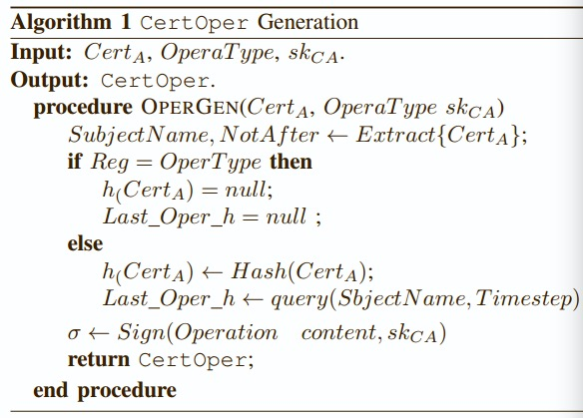
Application layer

Slide 55
III. CertChain Design
Application layer
2. Certificate validation
Check the $CBF_{2}$
Check the 𝐶𝐵𝐹_2
Not in -> valid
In ->next step
Check the $CBF_{1}$
Check the 𝐶𝐵𝐹_1
Not in -> revoked
In -> next step
Query blockchain the revoked status
Not in -> valid
In revoked

Slide 56
04
Security Analysis & Experiment
PART FOUR
Security analysis
Implementation
Performence evaluation

Slide 57
IV. Security Analysis & Experiment
Security and Analysis
Theorem 1
In CertChain, the certificate operation can be traced efficiently and certificate revocation checking can be fed back efficiently without false positives under DCBF.
High query efficiency
Theorem 2
By self and public audit, CertChain can tolerate the failure of defense mechanisms implemented in CAs or bookkeepers under the threat model.
Intrusion tolerance

Slide 58
IV. Security Analysis & Experiment
Implementation
PROGRAM & ENTITY | IMPLEMENTATION
Program language | Javascript(node.js), HTML, CSS, and PHP
RSA-2048 | OpenSSL (Version 1.0.1p)
Domain | Apache HTTP sever(V.2.4.7)
CA | OpenSSL
bookkeeper | Ethereum
Client | Chromium web browser
10 PCs | Intel E4300 (2.6GHz) , 4G, Ubuntu 14.04
10 bookkeepers | Inter Xeon E5-2682, 4GB, win server 2012
Block size: 2MB block interval:6.7s
Empty block size: 2.6KB CertOper size:1.8KB

Slide 59
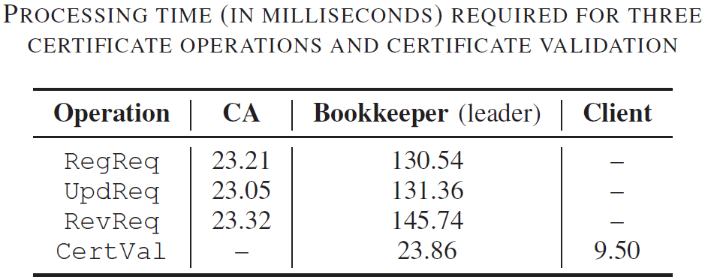
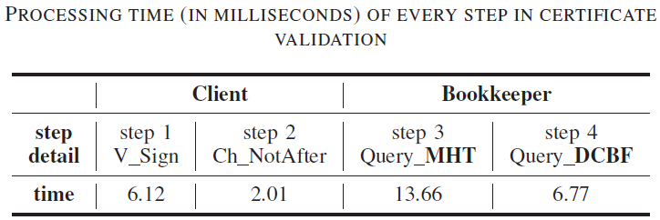
IV. Security Analysis & Experiment
Performance evaluation
The processes of certificate operation
the processing time of certificate validation

Slide 60
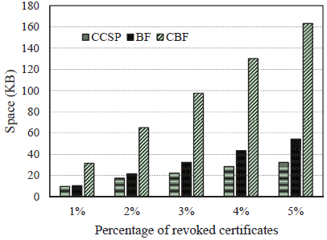
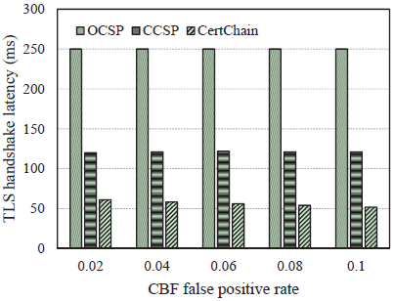
IV. Security Analysis & Experiment
Performance evaluation
Compare the processing time between CertChain and CCSP.

Slide 61
I. Introduction
Contributions
propose a decentralized public audit certificate management framework.
design a distributed dependability-rank based consensus protocol.
present a new data structure called CertOper to record certificates operations.
exploit a revocation checking method based on Dual counting bloom filter (DCBF).
implement a proof-of-concept prototype and evaluate the performance in practice.
06

Slide 62
V. Conclusion
Conclusion
1. Propose a public and efficient certificate audit scheme based on blockchain.
2. Design a distributed dependability-rank based consensus protocol.
3. Propose a new data structure called CertOper.
4. Present a DCBF to achieve economic space and efficient query for certificate revocation checking.

Slide 63
Questions?

